Slide 1
BUILDING A SEMSUPERVISED LEARNING FRAMEWORK FOR CREDIT RISK PREDICTION

Slide 2
Data Overview
Data was acquired from Higher Education Students Loans and Grants Board(HESLGB)
Synthetic data was generated from the sample acquired from HESLGB using borderlineSMOTE and CTGAN synthesizer from the synthetic data vault module.
The sample obtained from loans Board had 30 features including, not limited to; gender, marital status, and age. It had 355 rows containing data of varying types mainly objects and strings.
It had the target feature repayment status which had three classes namely fully paid, partially paid and unpaid.
The initial dataset also had missing values in some features namely; highest education, informed repayment obligations, program of study, region, loan purpose and total loan.
There was a class imbalance in the target variable, whereby 75.5% represented non default and 24.5% represented default.

Slide 3
System Design and Architecture
System components and interactions
Data ingestion module (collect data from database)
Data preprocessing module (clean, transform, encode data)
Semi-supervised learning module (split – train – label – augment)
Model training (supervised learning classifier model training)
Model evaluation (model performance assessment)
Model deployment (output results)

Slide 4





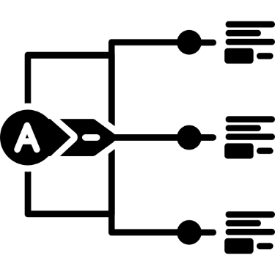
Data pipeline

Slide 5
Data collection
Data collected from database
preprocessing
Missing values, transformation , feature engineering
Data splitting
Labeled & unlabeled
SSL
Augmentation
Data splitting
Model training
Self-training, co-training
Combine datasets
Training, test, validation
Supervised classification
Model evaluation
Accuracy, precision, f1_score, confuzion

Slide 6
Tools and technologies used
Pandas
Numpy
Pyplot from matplotlib
Seaborn
Tensorflow
Synthetic Data Vault (SDV)
Sklearn

Slide 7
Data Preprocessing and Feature Engineering
Converted all column names to lower case
Converted all strings and object values to lowercase
Removed columns missing values based on a threshold of 50%
Imputed missing values using mode in categorical columns
Created a feature ,discipline in which different programs of study were grouped into similar academic disciplines
Derived another feature age group from age range in which the values were converted from object type to categorical type.
Features were selected using the Chi-squared and mutual information Statistics.

Slide 8
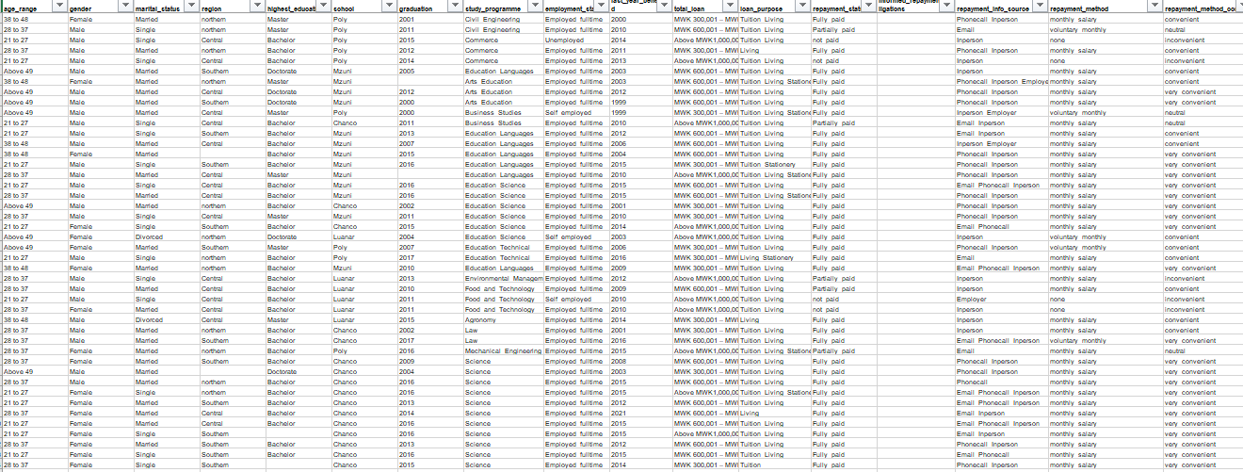
Dataset before preprocessing and feature engineering

Slide 9
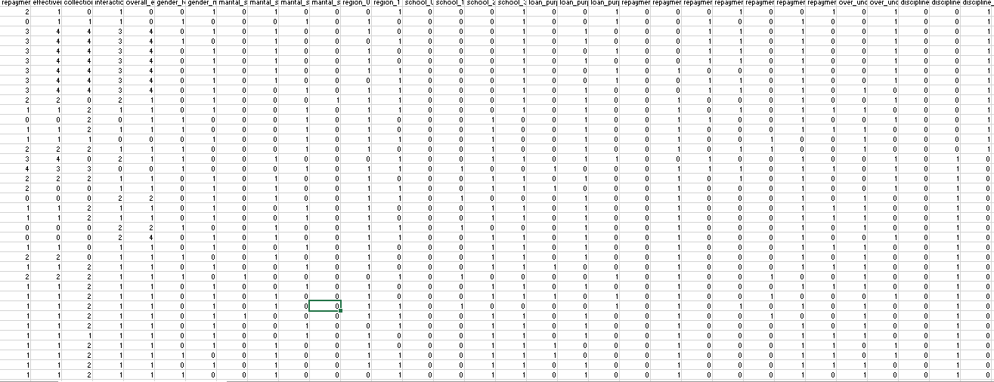
Dataset after preprocessing and feature engineering

Slide 10
Semi-supervised learning
Data splitting into labeled set and unlabeled set
X_labeled
X_unlabeled
y_labled
Random forest classifier trained on labeled set (X_labeled, y_labeled)
Random forest using unlabeled data to predict pseudo labeles (X_unlabeled used to predict labels y_predicted)
Dataset augmentation

Slide 11
Model Development
Both decision trees and random forest were used because their predictive accuracy is not affected by categorical features
Random forest classifier chosen as final model for it’s robustness over decision trees.
Decision trees | Random forest classifier
Less training time Less memory consumption Prone to overfitting Predictive power not affected by categorical features | More training time More memory consumption Less susceptible to overfitting Predictive power not affected by categorical features

Slide 12

Model evaluation
Confusion matrix

Slide 13
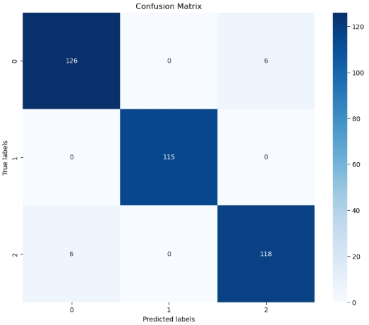
Model Evaluation
Confusion Matrix heatmap

Slide 14
Iterations and challenges
Low data quality for machine learning model development and training
Data preprocessing
Feature engineering
Feature selection
Synthetic data generation and integration
Categorical datatypes
Limited scope of solutions to tally with categorical data handling techniques. (data visualization, synthetic data generation, encoding)

Slide 15
Deployment using Flask
Steps involved in Flask deployment
Save trained model using joblib or pickle libraries
Creating Flask app using python eg app.py
Run Flask server
Sending Request to the API.

Slide 16
Why we have choose Flask than other methods
it is simple , lightweight and python based
it does not need data base like Django
it is cheap( free ) than other deplyments like AWS, AZURE
It is possible for localhosting
Simple structure and dependencies make Flask easy to package in Docker.

Slide 17
Purpose of app
Automates credit risk evaluation
Supports decision making
Improve loan approval accurancy

Slide 18
Features of credit risk management app
1. user authorisation
2.credit assessment module
*input fields
*Risk level classification(score on given input)
* decision recommendation (Aprove, Reject , review)
3. Dashbod and reports

Slide 19
How it works
Input customer data
App score using model
App gives recommendations and given score for particular individual
Then summarisation of score, graphs and recommendations.

